Slide 1
Compassion, Courage, Resilience
Dr Amina Muazzam

Slide 2
Compassion
Compassion is a language which the deaf can hear and the blind can see.
Compassion motivates people to go out of their way to help the physical, mental or emotional pains of another and themselves.
It is actually a sympathetic pity and concerns for the sufferings or misfortunes of others.

Slide 3
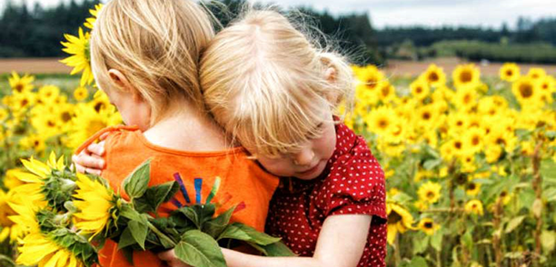
Components of compassion
A sensitivity to suffering in yourself and others.
A commitment to try to alleviate and prevent this suffering.
in both cases compassion involves courage and strength

Slide 4
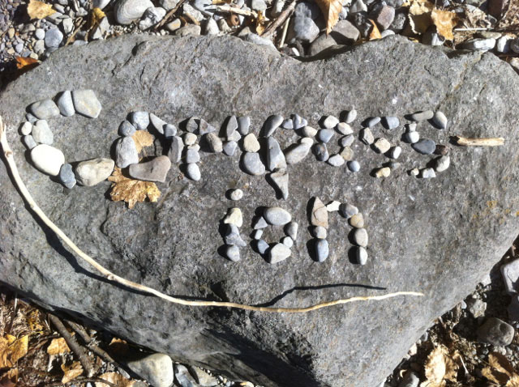
Types of compassion
Familial compassion (with family)
Familiar compassion (friends, neighbors)
Stranger compassion (global compassion)
Salient compassion (to lower animals)

Slide 5
Ways of showing compassion
Start with yourself – praise yourself for your success and forgive yourself for your mistakes.
Communicate verbally and non-verbally – eye contact, active listening, paraphrasing and open-ended questions.
Touch (if appropriate) – a gentle and soft touch to hand or shoulder during conversation.
Encourage others – positive reinforcement
Express yourself – match the facial expressions to your felt emotions, a sincere smile and a good laugh.

Slide 6
Continue…
Show kindness – give your kindness without expecting anything back.
Respect privacy – be attentive to someone’s privacy. Protect their dignity.
Learn how to advocate – to effectively advocate you must actively listen to what your friend needs.
Volunteer – spending time helping people is good for your body, mind and soul.
Consider your words – think before you speak

Slide 7
Courage
“COURAGE IS THE FIRST OF HUMAN QUALITIES BECAUSE IT IS THE QUALITY WHICH GUARANTEES ALL OTHERS”. (Winston Churchill)
It is the ability to do something that frightens one.
It is the capacity to control your fear in a dangerous or difficult situation.
It is a strength to be brave and confident enough to do what you believe in.

Slide 8
Types of courage
physical courage – allows us to risk, discomfort, injury, pain, facing an enemy on the battlefield, undergoing chemotherapy etc.
Social courage – risk of social embarrassment, unpopularity or rejection. It also involves leadership. Helps us apologize and move on.
Intellectual courage – willingness to engage in challenging ideas, to question and to risk of making mistakes.
Moral courage – it involves doing the right thing particularly when risks involve shame, opposition or the disapproval of others.
Emotional courage – it opens us to feeling the full spectrum of positive emotions at the risk of encountering the negative one.

Slide 9
Continue…
Spiritual courage – attending religious gatherings, making time to pray and do some charity.
Strengths associated with courage
Integrity (speak the truth, act sincerely, present yourself in an authentic way).
Bravery (speaking and acting for what you believe despite opposition)
Persistence (finishing what you start even in the face of resistance)
Vitality (entering life fully)

Slide 10
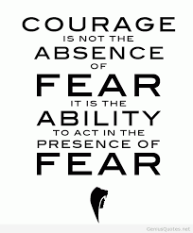
Traits of courageous people
They are realistic
They choose light over dark
They care deeply about their cause

Slide 11
Resilience
Resilience is the capacity to recover quickly from difficulties or toughness.
It is a sort of “miracle drug” personality trait, something that can heal all wounds and right all wrongs.
It is the ability and tendency to “bounce back”.

Slide 12
Bounce back
It is the process of adapting well in the face of adversity, trauma, tragedy, threats or significant sources of stress.
Bounce back is what we do when we face disappointment, defeat and failure but instead of letting things keep us down we get back and continue on with our lives.

Slide 13
The power of failure
The failure is the capacity to inspect and learn from.
Failures are stumbling blocks on the proverbial path to success.
The lessons they teach have implications for humility, maturity and empathy.

Slide 14
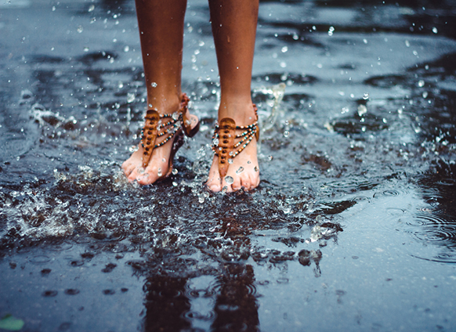
Characteristics of resilient people
A sense of control
Strong problem solving skills
Strong social connections
Identifying as a survivor, not a victim
Being able to ask for help
Sense of autonomy

Slide 15
Tips to improve resilience
Get connected
Make every day meaningful
Learn from experience
Remain hopeful
Take care of yourself
Be proactive
Learn to perceive obstacles as challenges rather than hindrances
Focus on progress, not goals
Practice your ABC’s

Slide 16
When to seek professional advice?
Becoming more resilient takes time and practice. If you don't feel you're making progress — or you don't know where to start — consider talking to a mental health provider. With guidance, you can improve your resiliency and mental well-being.

Slide 17
Resilience exercise
A visualization technique that can be used for this is to imagine the place you are in at the moment and slowly zoom out of yourself. Slowly zoom out of the building you're in, of the place, of the state, country and even continent. Then you zoom out further all the way through the ozone layer until you reach the moon and are looking at the whole earth. Now think about your problem again, how big is it really?

Slide 18
Thank you ☺

